Slide 1
An Update on Graph Cognition
Kuansan Wang, Managing Director
Microsoft Research Outreach
Redmond, WA USA

Slide 2
What Artificial Intelligence Means?
Creativity
Intuition, …
Knowledge Acquisition
Inferencing
Reasoning
Cognition
Computer Vision
Speech Recognition
Language Processing*
Recognition
Sensing

Slide 3
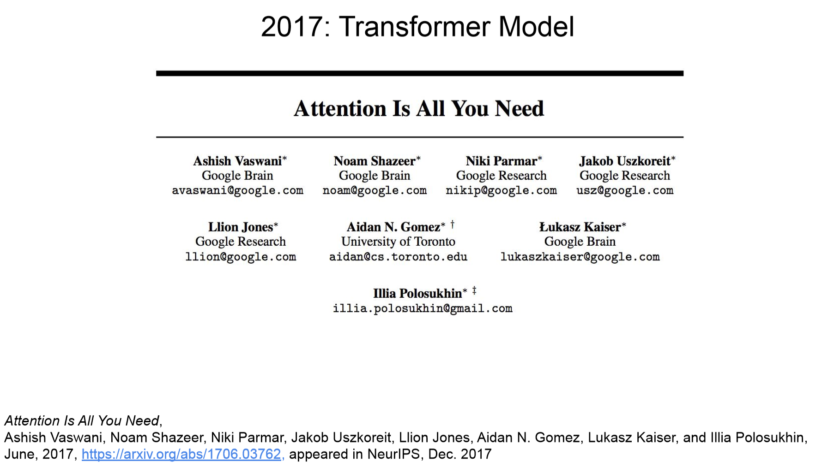
Language Understanding Case Study
Credit: Jeff Dean. WWW-2019

Slide 4
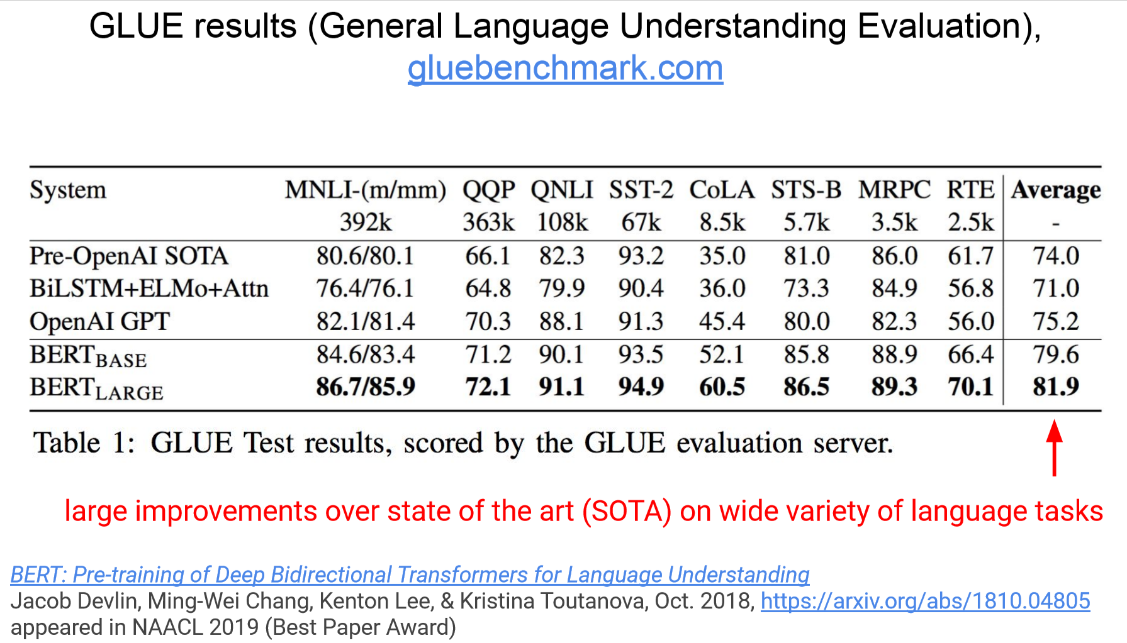
Bidirectional Encoder Representation Transformer
Credit: Jeff Dean. WWW-2019

Slide 5
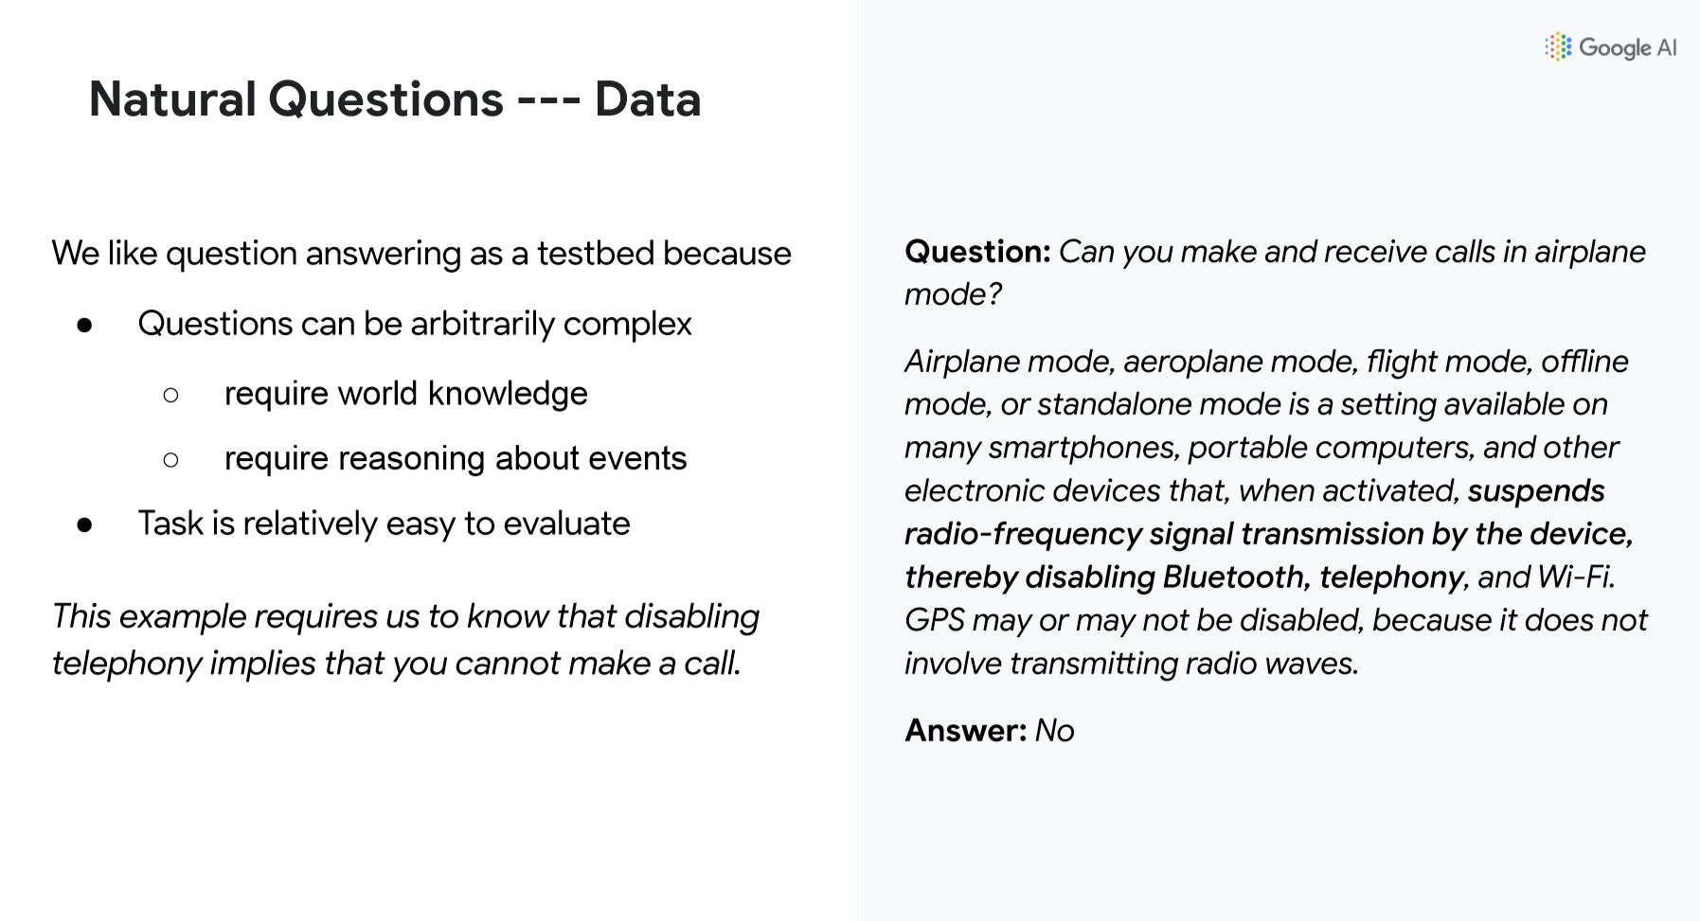
Credit: Jeff Dean. WWW-2019

Slide 6
Beyond Natural Language Semantics
Aggregation
  How to adjudicate disagreements
    Can you send and receive text messages in airplane mode?
  Answers not in linguistic forms
Many knowledge representations are already in graphs
Harmonizing statistical and expert system approaches
  Rules don’t have to be statistically learned
    What are top movies in Asia last decade?
  Explicit vs Implicit knowledge representation: best of both worlds

Slide 7
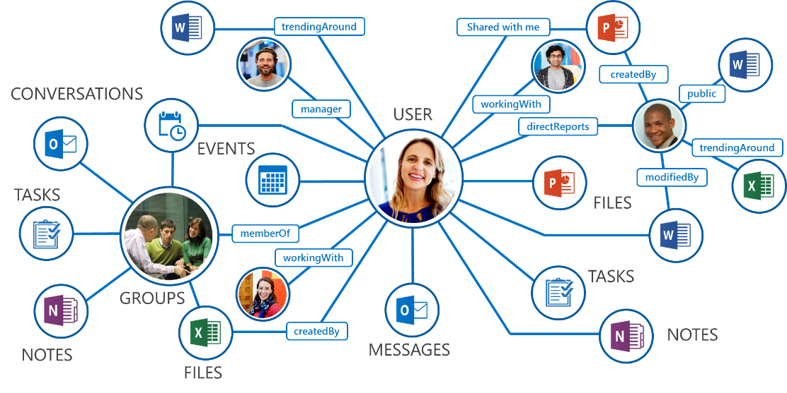
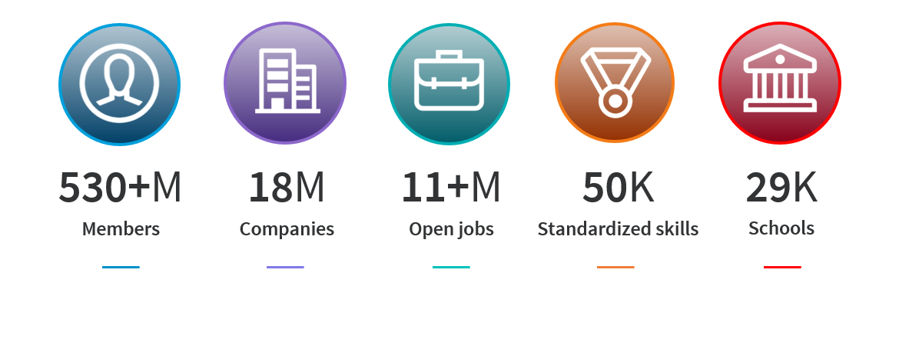
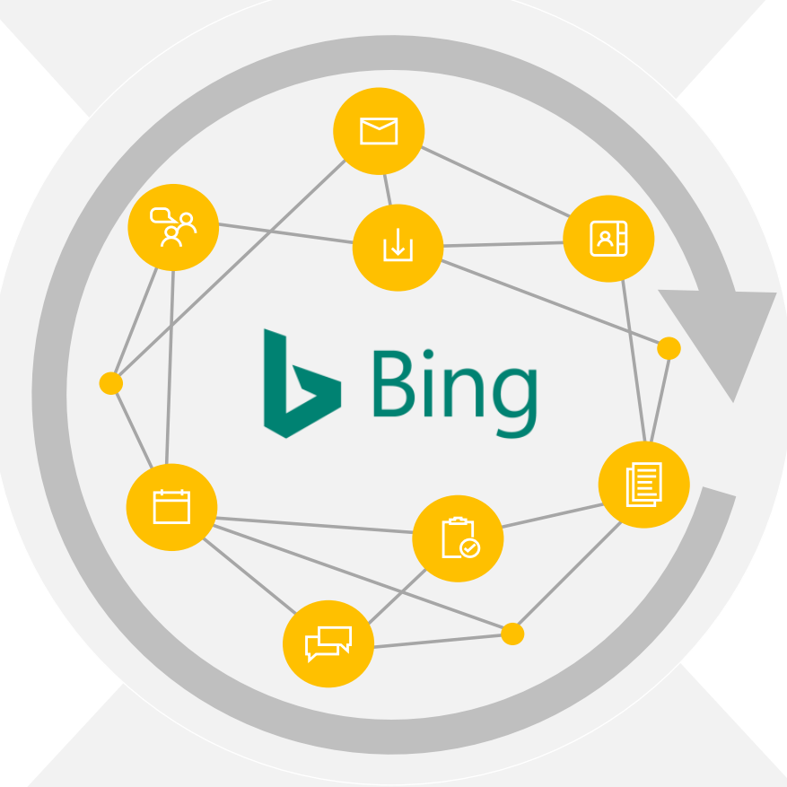






Knowledge Representation in Graphs from Microsoft
LinkedIn Economic Graph
Microsoft (Office) Graph
Microsoft Academic Graph
Bing Satori Knowledge Graph

Slide 8
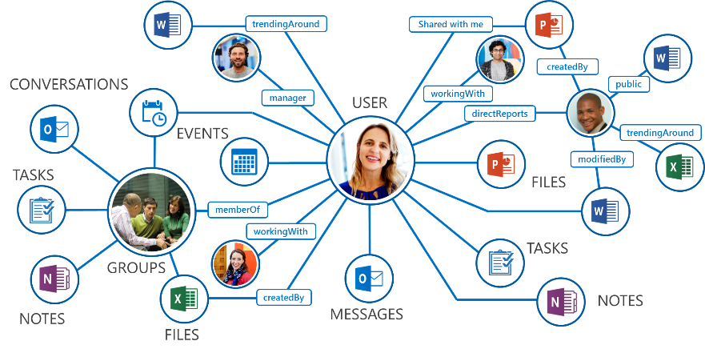
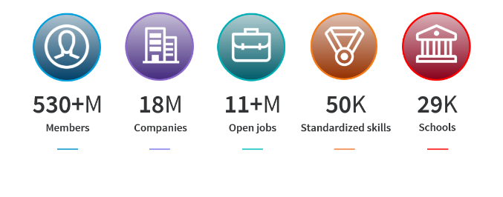
Heterogeneous, Hybrid, Dynamic Graphs
Different types of entities
Various types of relations
Text info and documents
Dynamic graphs

Slide 9
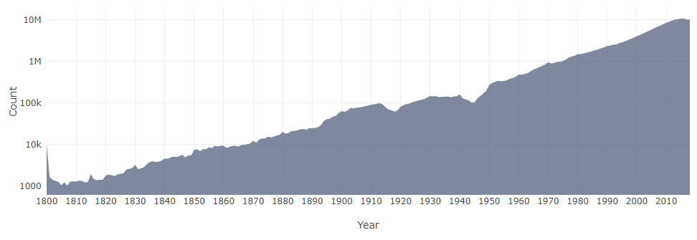
Microsoft Academic Graph
664,862
fields of study
48,757 journals
4,307 conferences
228 million papers/patents/books/preprints
230 million authors
25,570 Institutions
https://academic.microsoft.com as of Sep. 2019
The graph data is open!

Slide 10
Open Academic Graph
Cross linking between MAG and Aminer
  https://www.openacademic.ai/oag/
V2 release in August 2019
  MAG snapshot of November 2018
  Aminer snapshot of January 2019
Checkout paper at KDD 2019
Cognitive Tasks:
Name disambiguation
Spam/fake papers detection
Hot topics recognition & prediction
Scientific impact assessment
Community detection
Infer future paper title
Related entities

Slide 11
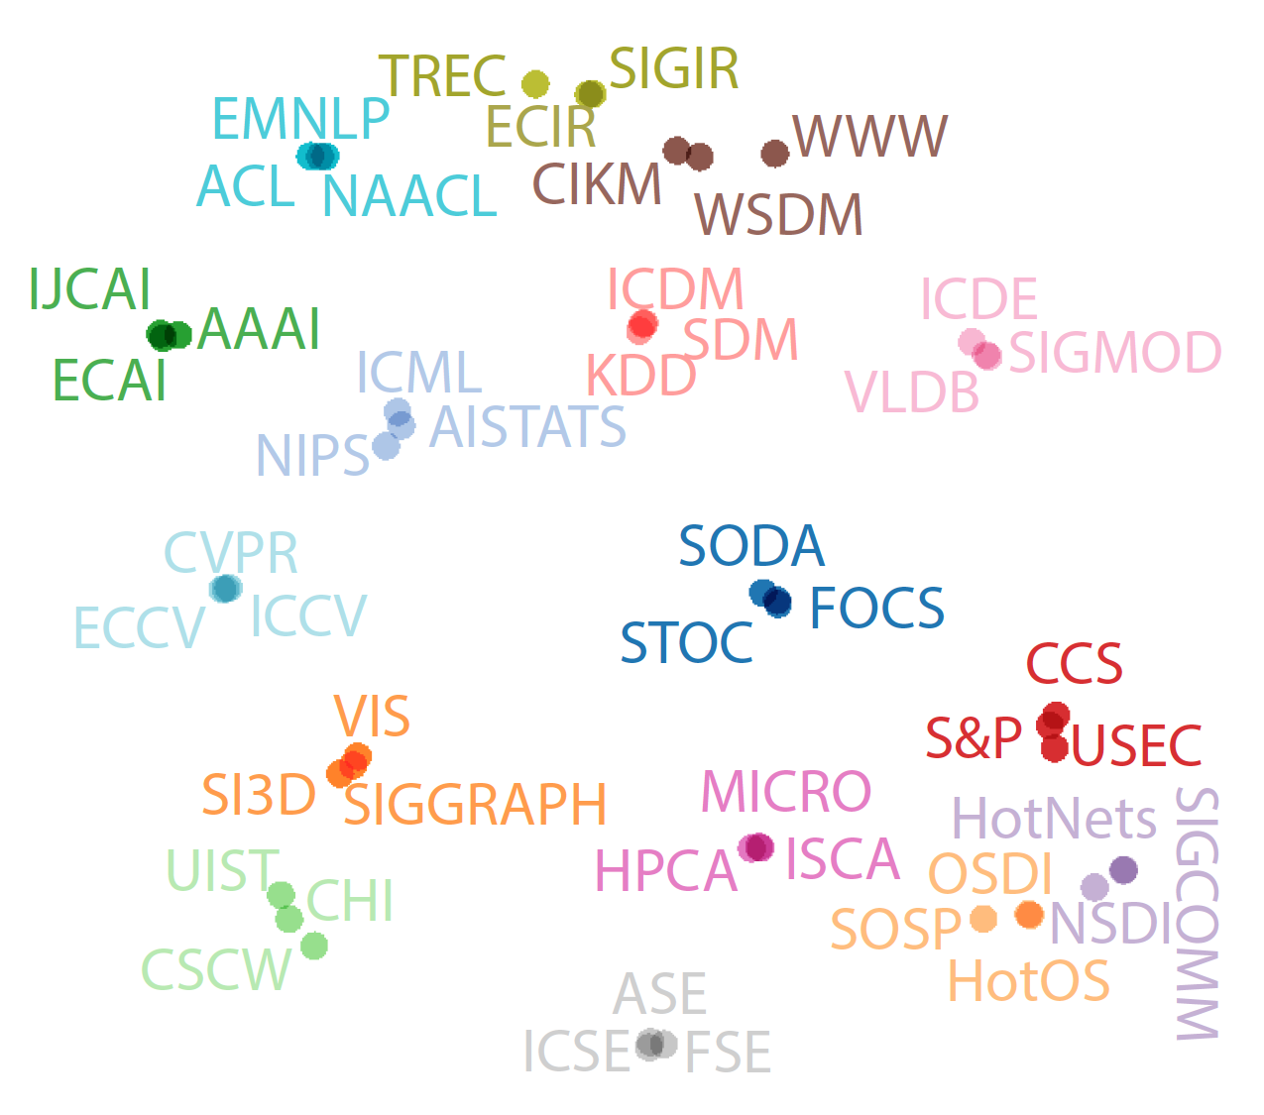
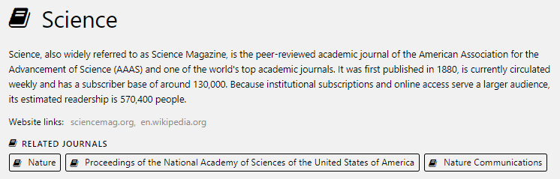
Related Venues
https://academic.microsoft.com/
metapath2vec: scalable representation learning for heterogeneous networks. In KDD 2017.

Slide 12
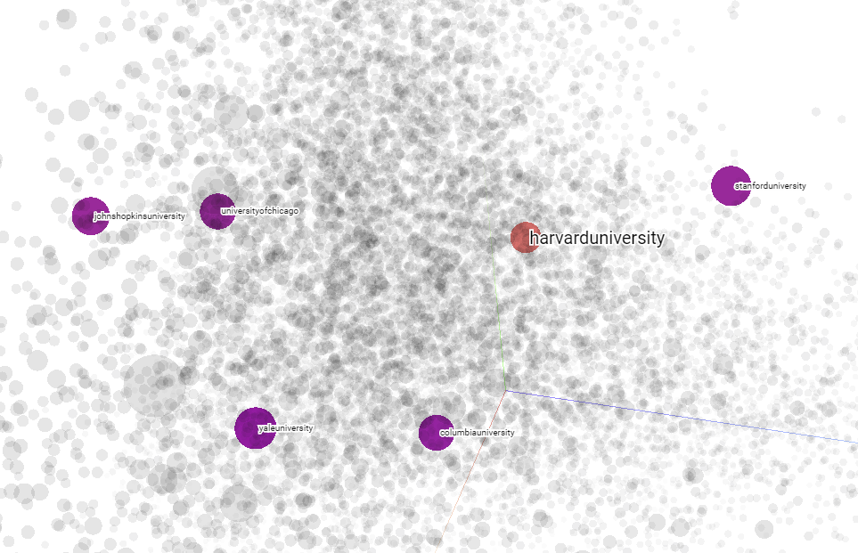
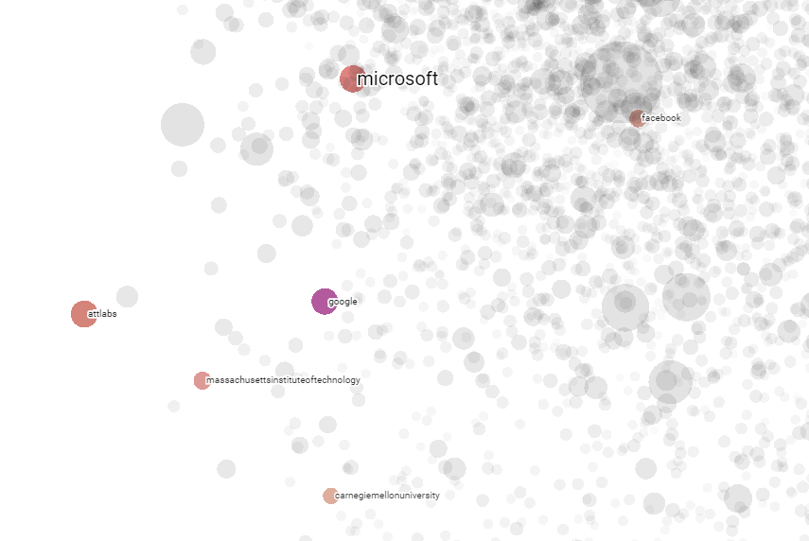
Related Institutions
Microsoft
Stanford
Facebook
Harvard
Johns Hopkins
UChicago
AT&T Labs
Google
MIT
Yale
Columbia
CMU
https://academic.microsoft.com/
metapath2vec: scalable representation learning for heterogeneous networks. In KDD 2017.

Slide 13
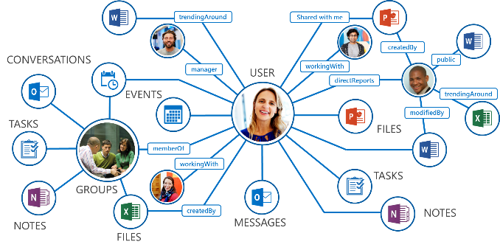
Pre-training with Dynamic Heterogeneous Graphs
  Can we pre-train with dynamic heterogeneous graphs and leverage the model to solve different down-stream tasks and applications?

Slide 14
Transformer Model for Graph Reasoning
Joint work between MSR and UCLA
  MSR: Yuxiao Dong
  UCLA: Ziniu Hu, Yizhou Sun
Masking language model => masking nodes/edges
Under peer review

Slide 15
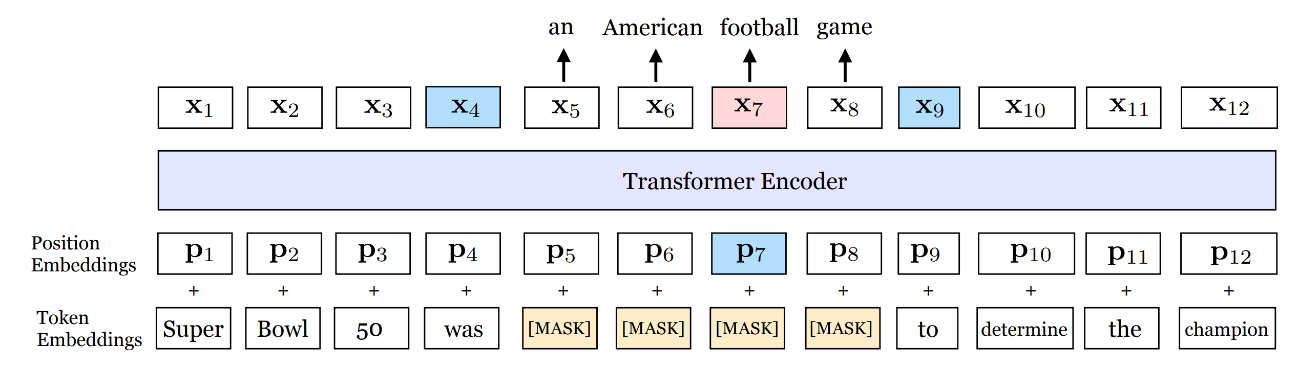
Pre-training with Dynamic Heterogeneous Graphs
  Recent progress of pre-training language models in NLP
    ELMO, BERT, XLNet etc.

Slide 16
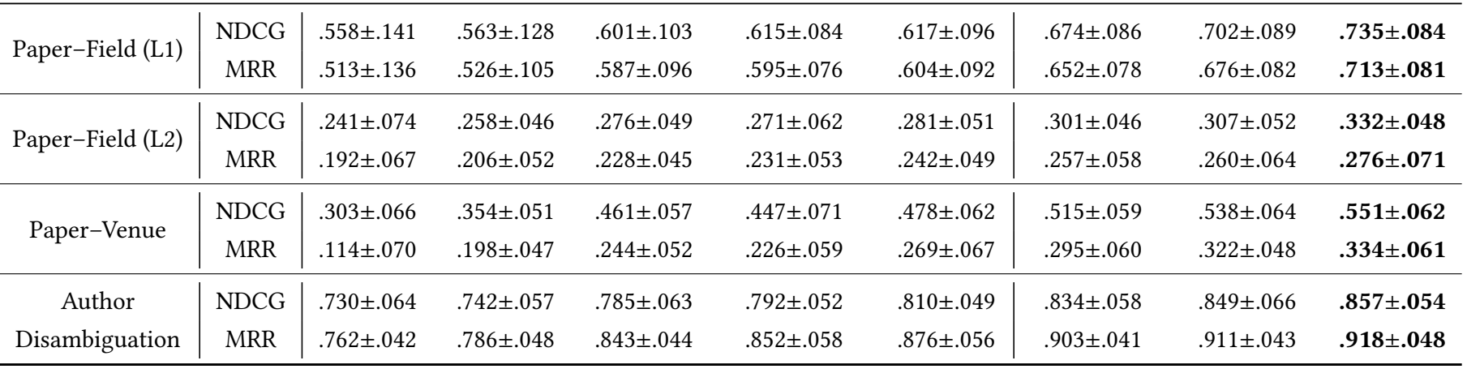
Infer Paper Field

Slide 17
Infer Paper Venue

Slide 18
Infer Paper Field

Slide 19
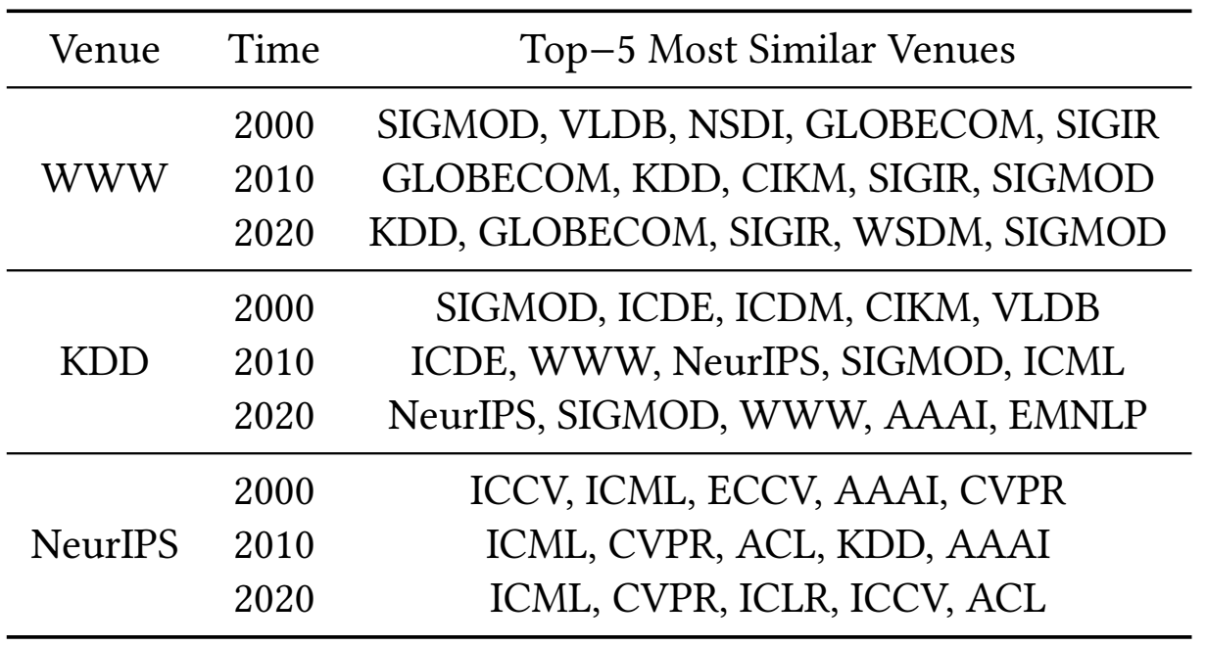
Case Study: Temporal Evolution
DB + Networking + IR
DM + Networking + IR + DB

Slide 20
Case Study: Temporal Evolution
DB + DM
ML + DB + Web + AI + NLP!!!

Slide 21
Case Study: Temporal Evolution
CV + ML + AI
ML + CV + DL + NLP

Slide 22
Summary
Heterogeneous Graph Transformer
  A pre-training model that can learn to capture complex dependencies of entities with different types, relationships, and timestamps (without labeled data)
Event-driven Info-NCE Training
  A learning objective that can guide a single model to learn all the relationships simultaneously
  Train and Pre-Train billion-scale dynamic & heterogeneous networks

Slide 23
Microsoft Academic Graph
664,862
fields of study
48,757 journals
4,307 conferences
228 million papers/patents/books/preprints
230 million authors
25,570 Institutions
https://academic.microsoft.com as of Sep. 2019
The graph data is open!

Slide 24
  Thank you!

